Slide 1
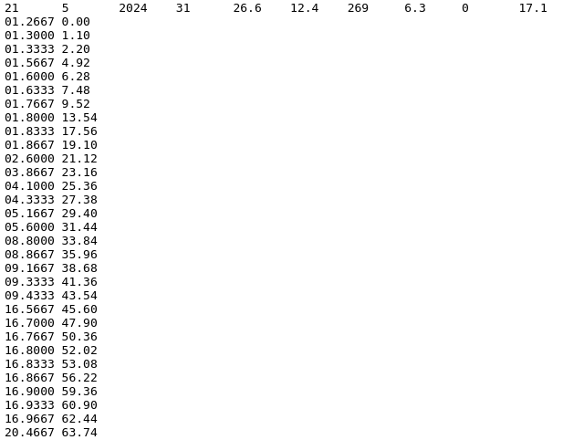
How DEP generates this, 626,507 times per day!
Daryl Herzmann
akrherz@iastate.edu
10 June 2024

Slide 2
Life Goals and Life Choices
Given that:
WEPP, our soil erosion model, outputs at a daily timestep.
We want to produce estimates of yesterday by the time old folks wake up in the morning (6 AM).
Within our model inputs, the weather information is updated daily.
We need complete/high resolution weather inputs available by 1 AM for previous day
For precipitation, we are bound to RADAR-based estimates (MRMS)
For other variables, we are bound to grid analyses (NCEP RTMA) or weather model analyses (HRRR)
A 0.01x0.01 degree grid is about the best that currently can be done.
For WEPP, we need to generate break-point climate/weather files.

Slide 3
Climate file daily text format
Avg Wind Direction [always zero for DEP]
Day
Month
Year
Solar Rad Langleys
High Temp C
# Breakpoints
Low Temp C
Avg Wind Speed mps
Avg Dew Point C
Breakpoint Precip
decimal time, Accum precip mm

Slide 4
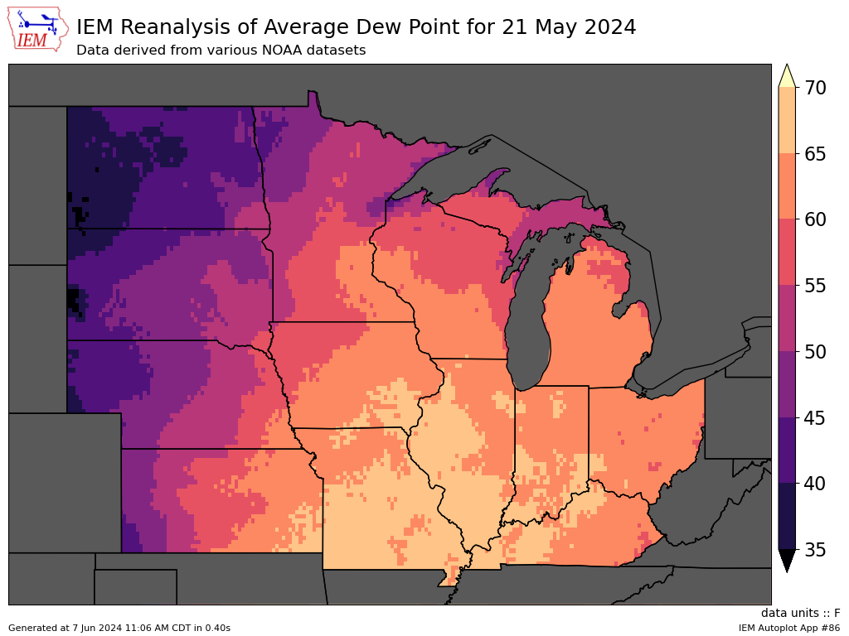
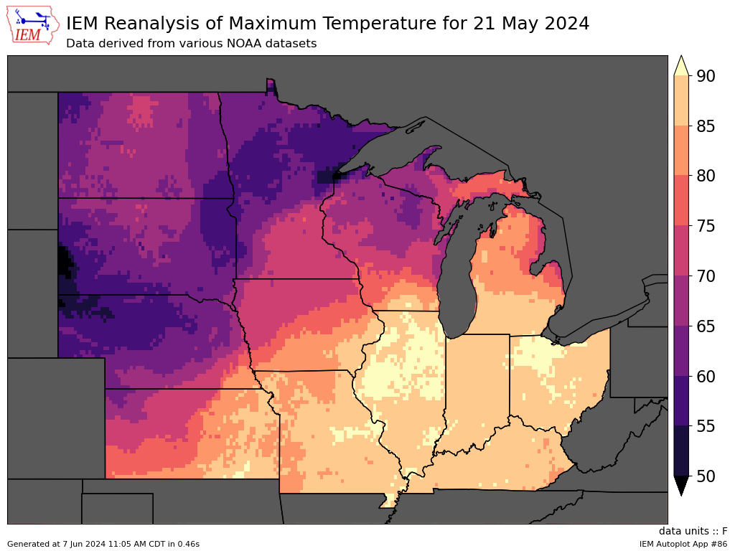
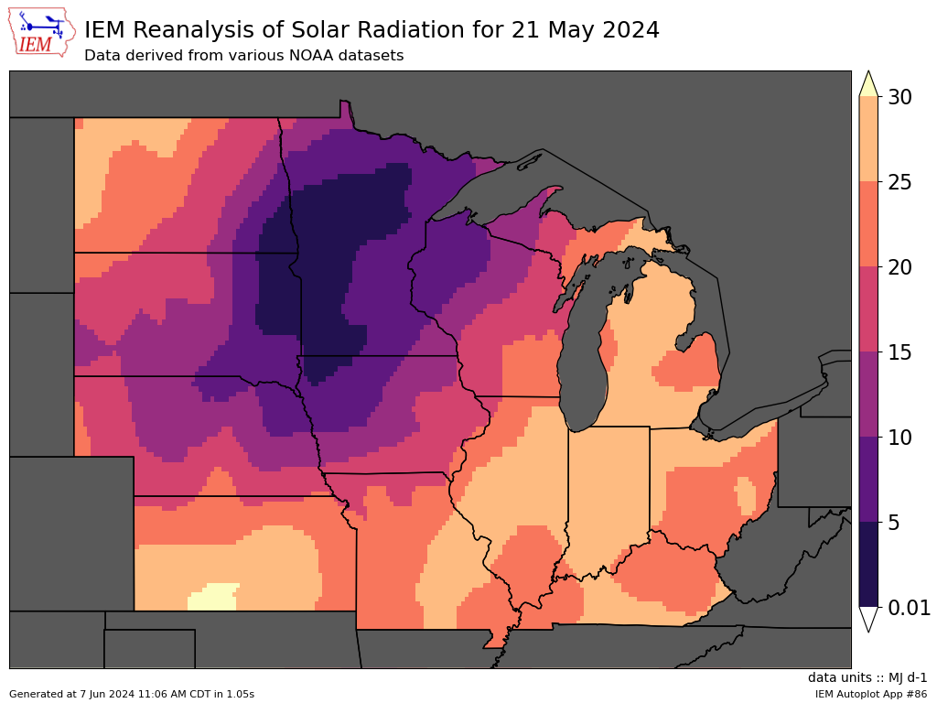
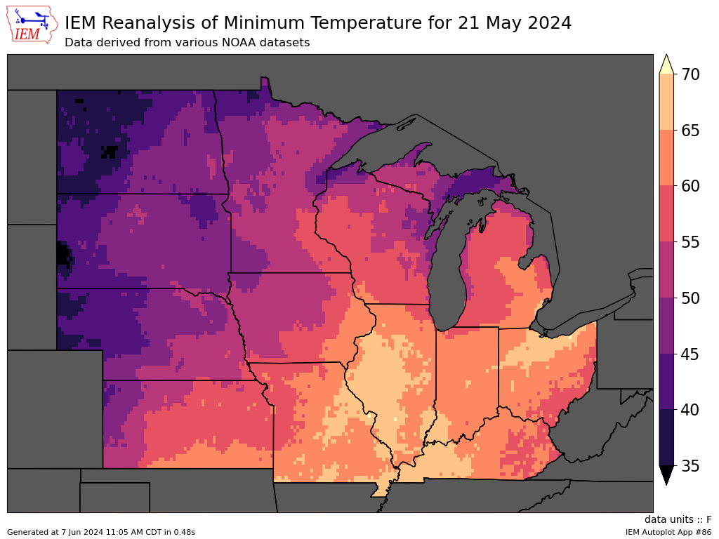
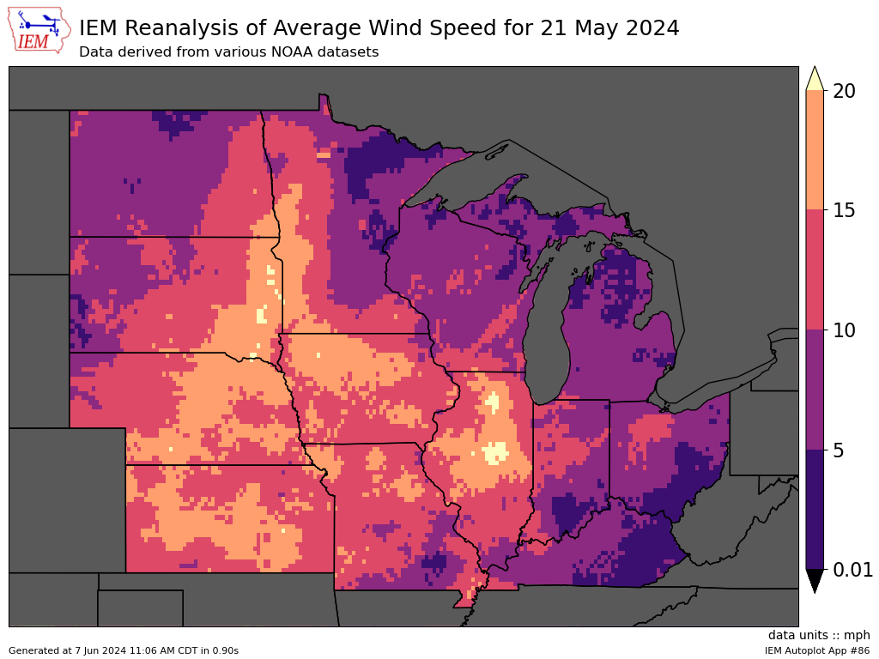

Slide 5
Breakpoint Generation Life Choices
WEPP has a breakpoint per day limit of 100, so we can’t feed it potentially 24x30=720 breakpoints
So the 2 minute data is consolidated such that
2 minute accumulations of >= 1 mm are retained
Every 2 mm of accumulation is retained
If this yields more than 100 points, we increment up the thresholds and try again until we get less than 100 points
NOTE: decimal time needs 4 digits to keep minute values precise to the second…

Slide 6
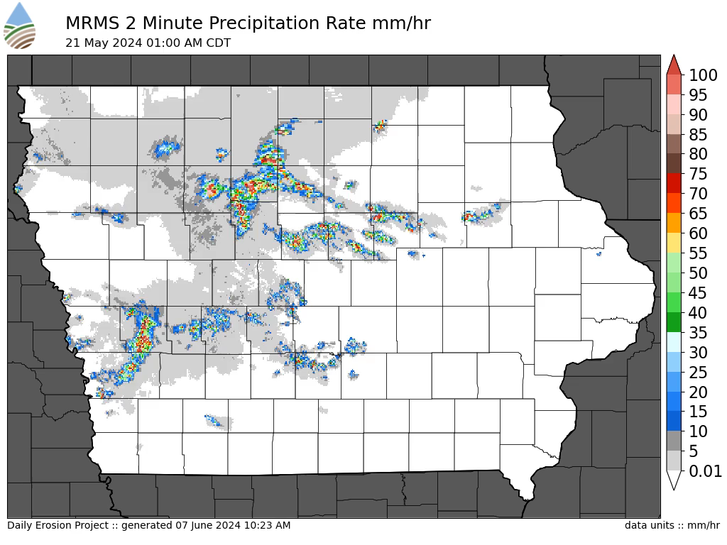

Slide 7
Scaling Pains
Presently, 8 CPU + ~32GB memory takes 20 minutes to process the 600k CLI files for a **single** given day.
This presents a problem when we bootstrap a new area, spinning up 18 years of climate files is non-trivial
So a 0.10x0.10 grid of climate files over land over the CONUS (for areas we do not currently model) is maintained to allow a quick “warm-start”
Daily reprocessing selectively picks 17 previous dates and 10 days ago to regenerate all climate file data for those dates and reprocess erosion results. Precip data is more QC’d by then.

Slide 8
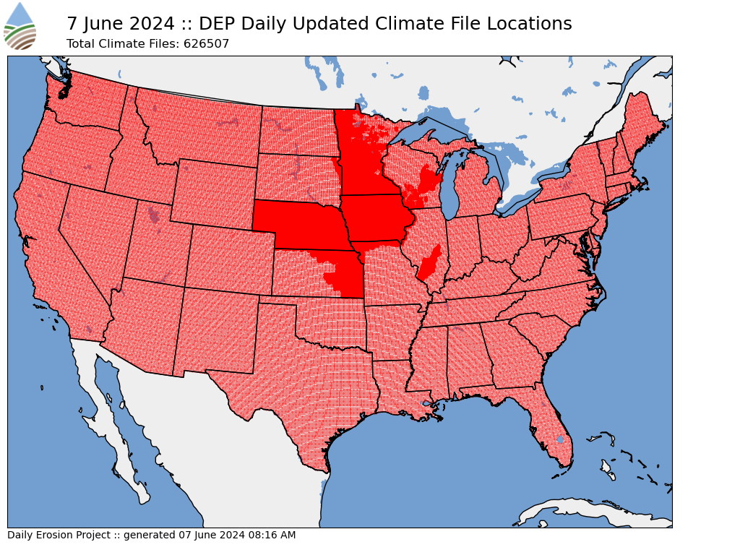

Slide 9
Part II: Running WEPP

Slide 10
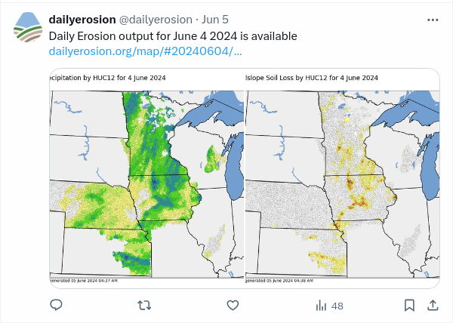
It is 1:20 AM, our climate files are all edited.
Now we need to run ~1 million WEPP hillslope runs
Thankfully
Each hillslope 18 year run takes about a second
We have about 70 distributed processors available that are listening to a central RabbitMQ server
So this processing finishes at about 4 AM.
Another 15 minutes to postprocess the output files, insert summarized information to the database.
We spam Twitter/X.

